Slide 1
HW2

Slide 2
Shader
A program designed by user
Runs in GPU
Vertex
Vertex Shader
Fragment Shader
Frame Buffer
Input: A vertex
Output: A vertex
Input: A pixel
Output: Pixel value

Slide 3
Use Shader
First, create shader
GLint glCreateShader(GLenum shaderType)
Create a shader object with specified shader type
shaderType : GL_VERTEX_SHADER, GL_FRAGMENT_SHADER in this homework
void glShaderSource(GLint shader, GLsizei count, const GLchar **string, const GLint *length)
Set the source code if shader to string
void glCompileShader(GLint shader)
Compile the shader

Slide 4
Use Shader
Then, create shader program
GLuint glCreateProgram()
Create a program object
void glAttachShader(GLuint program, GLuint shader)
Attach shader to program
void glLinkProgram(GLuint program)
Link the program
void glDeleteShader(GLunit shader)
Delete the shader after link

Slide 5
Use Shader
while (!glfwWindowShouldClose(window))
{
glUseProgram(program);
// Pass parameters to shader program
// Draw with the shader program
glUseProgram(0);
// Stop using program
glUseProgram(another_program);
// …
}

Slide 6
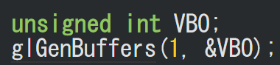

VBO (Vertex Buffer Object)
Passing data from CPU to GPU is relatively slow
We can send a large amount of data to GPU at one time to speed up execution
1. void glGenBuffer(GLsizei n, GLuint *buffers)
Generate n buffer(s), stored in buffers
2. void glBindBuffer(GLenum target, GLuint buffer)
Bind buffer to target, which is GL_ARRAY_BUFFER in this homework

Slide 7

VBO
3. Set up the data
4. void glBufferData(GLenum target, GLsizeptr size, const GLvoid *data, GLenum usage)
Copy the data into buffer
GL_STATIC_DRAW:
Data is set only once and is used many times

Slide 8
Vertex Attribute Pointer
We now need to specify how openGL interprets the data
void glVertexAttribPointer(GLuint index, GLint size, GLenum type, GLboolean normalized, GLsizei stride, const GLvoid *pointer)
Index: sets the location of the vertex attribute
Size: the size of vertex attribute every vertex
Stride: the spacing between consecutive vertex attributes
Pointer: the offset where the data begins in the buffer
void glEnableVertexAttribArray(GLuint index)
Enable the vertex attribute

Slide 9
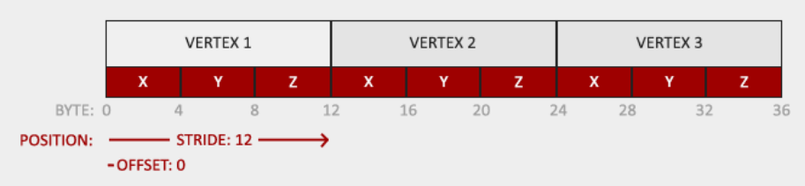

Vertex Attribute Pointer
void glVertexAttribPointer(GLuint index, GLint size, GLenum type, GLboolean normalized, GLsizei stride, const GLvoid *pointer)

Slide 10
VAO (Vertex Array Object)
A model may have multiple vertex attribute pointer
We can use a VAO to store all vertex attribute pointer
First, create a VAO and set up all its VBO and vertex attribute pointer. Then, simply bind the VAO to render the model.

Slide 11
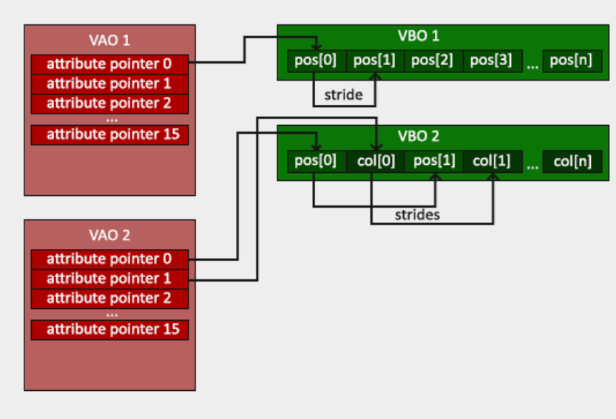
VAO (Vertex Array Object)

Slide 12
VAO setup
1. void glGenVertexArrays(GLsizei n, GLuint *array)
Create VAO
2. void glBindVertexArray(GLuint array)
Bind a VAO
3. Set VBO and vertex attribute pointer up
4. Unbind VAO by glBindVertexArray(0)

Slide 13
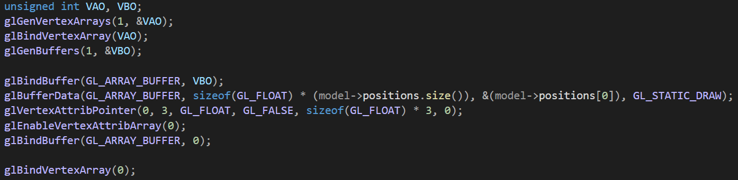
VAO setup

Slide 14
VAO during rendering
while (!glfwWindowShouldClose(window))
{
// Bind the VAO of desired model
glBindVertexArray(VAO);
// Draw the model
glDrawArrays(GL_TRIANGLES, 0, vertexCounts);
// Unbind VAO after use
glBindVertexArray(0);
}

Slide 15
Send Data to shader - Uniform
In openGL:
glm::mat4 matrix(1.0f);
unsigned int loc = glGetUniformLocation(program, “matrix”);
glUseProgram(program);
glUniformMatrix4fv(loc, 1, GL_FALSE, glm::value_ptr(matrix));
In GLSL:
uniform mat4 matrix;
https://registry.khronos.org/OpenGL-Refpages/gl4/html/glUniform.xhtml

Slide 16
GLSL
C-like language for shaders
Version number
// example vertex shader
#version 330 core
layout (location = 0) in vec3 position;
uniform vec4 color;
out vec4 vertexColor;
void main()
{
gl_Position = vec4(position, 1.0f);
vertexColor = color;
}
Input from vertex attribute pointer
Input from uniform
Output to fragment shader
Must assign gl_Position of type vec4 in vertex shader

Slide 17
GLSL
// example fragment shader
#version 330 core
in vec4 vertexColor;
out vec4 fragColor;
void main()
{
fragColor = vertexColor;
}
Interpolated input from vertex shader
Color output
Must output a vec4 as color in fragment shader

Slide 18
GLSL
Variable type
vec2, vec3, vec4, …
int, float, bool, …
mat2, mat3, mat4, …
…
Basic functions
min, max, sin, cos, pow, log, …
dot, normalize, …
transpose, reverse, …

Slide 19
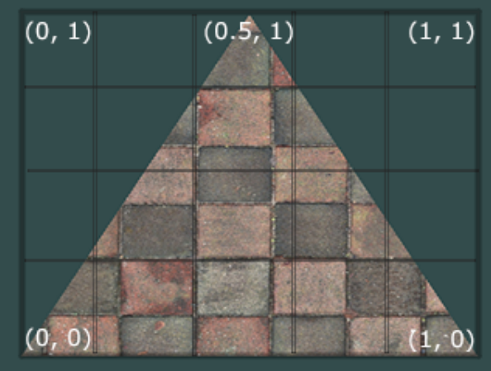
Texture
A vertex is assigned with a texture coordinate
Color is sampled with the texture coordinate

Slide 20
Load Texture
void glEnable(GL_TEXTURE_2D)
Enable 2D texture
void glGenTexture(GLsizei n, GLuint *texture)
Generate a texture
void glBindTexture(GLenum target, GLunit texture)
Bind texture so following call affect to bound texture
void glTexImage2D(GLenum target, GLint level, GLint internalformat, GLsizei width, GLsizei height, GLint border, GLenum format, GLenum type, const void *data)
Generate 2D texture image with given image data

Slide 21
Load Texture
void glTexParameteri(GLenum target, GLenum pname, GLint param)
Texture coordinates usually range from (0, 0) to (1, 1). We can define how to deal with coordinates outside [0, 1]. (default to GL_REPEAT)
glTexParameteri(GL_TEXTURE_2D, GL_TEXTURE_WRAP_S, GL_REPEAT)
glTexParameteri(GL_TEXTURE_2D, GL_TEXTURE_WRAP_S, GL_REPEAT)
Texture coordinates are float point value regardless of resolution. We need to decide which texture pixel to map the texture coordinate to
glTexParameteri(GL_TEXTURE_2D, GL_TEXTURE_MIN_FILTER, GL_NEARSET)
glTexParameteri(GL_TEXTURE_2D, GL_TEXTURE_ MAG_FILTER , GL_LINEAR)

Slide 22
Use Texture
You can pass more then one texture to shader.
In that case, you need to tell openGL which texture unit a texture sampler uses
// tell openGL which texture unit a sampler belong to
// texture unit 0 to ourTexture sampler
glUniform1i(glGetUniformLocation(, “ourTexture"), 0);
while (!glfwWindowShouldClose(window))
{
glAvtiveTexture(GL_TEXTURE0);
glBindTexture(GL_TEXTURE_2D, texture);
// Draw with shader
}

Slide 23
Use Texture in GLSL
// example texture fragment shader
#version 330 core
in vec4 vertexColor;
in vec2 texCoord;
uniform sampler2D ourTexture;
out vec4 fragColor;
void main()
{
fragColor = texture(ourTexture, texCoord);
}

Slide 24
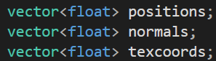
HW2
Goal: use GLSL to draw a cat and a box and apply some effect with shader
Some parameters you may need:
model->positions
model->normals
model->texcoords
Box: scale (0.0625, 0.05, 0.05)
Cat: rotate 90 degrees around +y axis
Both rotate 90 degrees/second
Hint: glfwGetTime() return the time in second from initialization

Slide 25
HW2 – special effect
Effect 1: model deformation
Create deformation effect by changing vertices positions
Flattening, squeezing, …, you can do any effect you want
Effect 2: change color
Change PART of the pixels color
For instance, you can use a threshold to find the strips of the cat and darken them
You can do any effect you want
Both effects are initially off and are triggered by key press
Tell us what you did and how to activate them in report

Slide 26
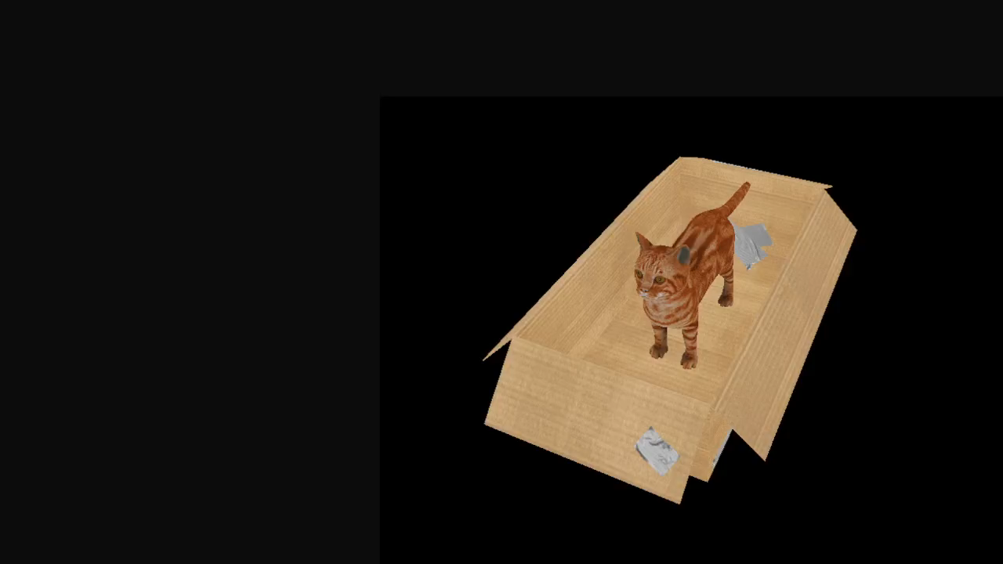
HW2

Slide 27
HW2 - score
Basic shader program(10%)
Set up VAO for cat and box (10% each)
Set up texture for cat and box (10% each)
Pass perspective, view, transform matrices, textures through uniform (10%)
Hint: getPerspective(), getView()
Effects (10% each)
Bonus (10%) – do anything you want without breaking the spec
Please have your bonus activated after pressing a key, so that we can judge your program without the bonus
Amazing deformation/color effect will also get bonus point!

Slide 28
HW2 – report (20%)
Include your name and student ID in the report
Tell us how you do your homework
Don’t paste your code without explanation
Describe problems you met and how you solved them
Explain your bonus and how to activate (optional)
File name: studentID_report.pdf

Slide 29
HW2 - submission
Deadline: 2022/11/22 23:59:59
Pack your project and report in a zip file. File name should be studentID_hw2.zip
10% penalty for each week late

Slide 30
HW2 – reference
https://learnopengl.com/
https://www.glfw.org/docs/3.3/index.html

